Slide 1
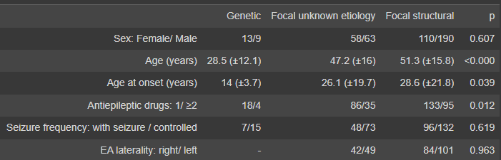
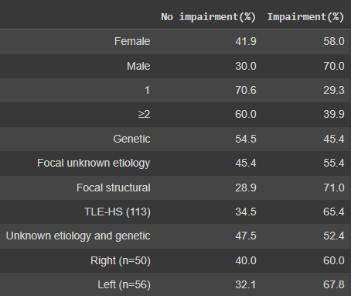
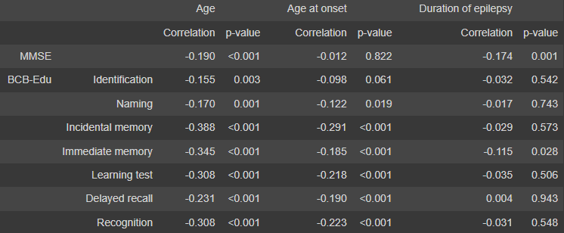
Cognitive Deficits in Epilepsy: Data Analysis
Bryce Whitcomb
NEU 494: Data Analysis in Neuroscience
April 20, 2023
Background
Data
Results and Interpretations
What is epilepsy?
Table 1
Table 1 presents data persisting to general information about the subjects from the study. The column “Genetic” refers to the subjects who had epilepsy with genetic etiologies, “Focal unknown etiology” refers to the subjects who had epilepsy with no secondary diagnosis for the cause of their seizures, and “Focal structural” refers to the subjects who had epilepsy in which seizures begin in specific region(s) of the brain.
Table 1
Epilepsy is a disorder in which someone experiences chronic seizures. Seizures are abnormal / excessive neuronal activity that occurs abruptly causing changes in behavior and bodily functions. Epilepsy has a large spectrum of severity and specific cognitive impairments that can vary greatly across its many subtypes.
Table 1 provides general information regarding the subjects used in the study, however it does also provide some information regarding general trends for epilepsy and information that is important for understanding the rest of the study.
Genetic epilepsies tended to have earlier onsets, which could also cause them to show greater impairment. Focal unknown and focal structural epilepsy subjects both tended to have their epilepsy for longer periods of time, which could also result in greater impairment.
Subjects who reported taking two or more antiepileptic medications were proportionately more likely to be without recurrent seizures.
Objective
This project intends to quantify and visualize how these impairments differ across different epilepsy types as well as how it can also influence cognitive functions.
Information On Data Used
Table 2
The data used in this project is obtained from the 2020 study “Cognition and epilepsy: Cognitive screening test.” The information obtained from this study include the performances of different cognitive tests conducted on participants with several different etiologies of epilepsy as well as control participants.
Table 2
Table 2 showed correlations between several characteristics and whether or not subjects had cognitive impairments in the study.
Male participants were proportionately more likely to show impairment than Female subjects. Subjects taking two or more medications showed more impairment than those taking only one. Focal structural epilepsies had significantly higher rates of impairment. Subjects with Temporal lobe epilepsy with hippocampal sclerosis (TLE-HS (113)) also showed disproportionately high rates of impairment. Left hemisphere epilepsy also had a slightly higher rate of impairment when compared to right hemisphere epilepsy.
Table 2 provides data from the study which categorized whether or not the subjects experienced any cognitive impairments. This data represents the subjects’ general information and their proportions of no impairment and impairment.
Methodology
A simple algorithm used in this project was created for the data presented in table 2. This algorithm calculates the proportion of subjects that experienced no cognitive impairments as well as the proportion that experienced multiple cognitive impairments based on several different characteristics of their epilepsy. This process is done through a few steps:
Pulling the data from the spreadsheets from “Cognition and epilepsy: Cognitive screening test” and loading it into a dataframe.
Calculating the sum of subjects for each characteristic by adding the number that experienced no impairments and the number that experienced impairments for each row.
Divide each cell by the sum of its row to determine the proportion (%) of subjects for each category.
Table 3
Table 3 showed the correlation between impairment and subject age, age of onset, and duration of epilepsy. Nearly every task had a negative correlation, meaning they all showed impairment.
The biggest determinant of impairment seemed to be age, which had the most negative correlation across all tasks. Age at onset and duration of epilepsy seemed to have inverse correlations of impairment; when one showed a more negative correlation the other had a relatively positive correlation.
Table 1
The data in table 3 presents the specific tests which were conducted in order to determine if there was any impairment in the subjects or not. This data was cross referenced with the the age of the subjects, age of epilepsy onset, and the duration of epilepsy in order to determine any correlation with task performance when compared to the control group of non-epileptic subjects.
Conclusions
Overall the data from this study shows clear correlations between epilepsy and cognitive impairment. Further studies are needed to determine further correlations however. Some confounding results occurred, such as an increased rate of impairment in subjects who took two or more medications, despite them also being less likely to have recurrent seizures.
As more studies of this nature take place, the cognitive impairments and potential treatments of epilepsy will continue to be further understood.
Sources Cited
Tedrus, G. M., Passos, M. L., Vargas, L. M., & Menezes, L. E. (2020). Cognition and epilepsy: Cognitive screening test. Dementia & Neuropsychologia, 14(2), 186–193. https://doi.org/10.1590/1980-57642020dn14-020013
Aldenkamp, A., &amp; Arends, J. (2004). The relative influence of epileptic EEG discharges, short nonconvulsive seizures, and type of epilepsy on cognitive function. Epilepsia, 45(1), 54–63. https://doi.org/10.1111/j.0013-9580.2004.33403.x

